Slide 1
Syllabus of module 2
Inheritance - Super Class, Sub Class, The Keyword super, protected Members, Calling Order of Constructors, Method Overriding, the Object class, Abstract Classes and Methods, using final with Inheritance.

Slide 2
Inheritance
The mechanism of deriving a new class from existing class is called Inheritance.
The old/existing class is known as the base class(or super class or parent class)
The new one is called the subclass (or derived class or child class).
A subclass is a specialized version of a superclass.
It inherits all of the instance variables and methods defined by the superclass and adds its own, unique elements.
extends is the keyword used to inherit properties of one class.
Syntax:
class subclass_name extends superclass_name
{
// body of class
}

Slide 3
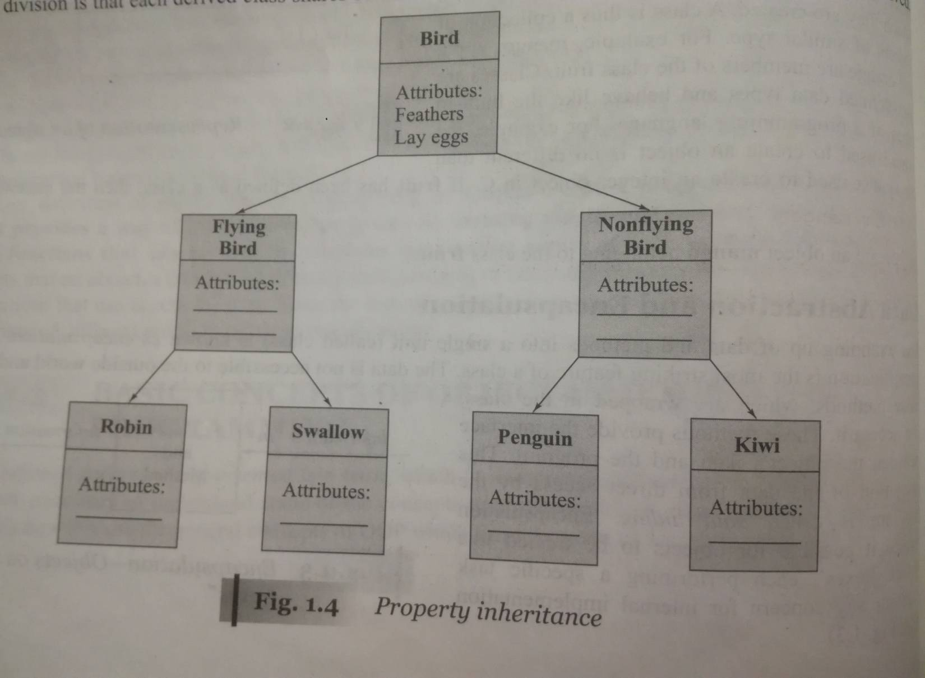
Inheritance

Slide 4
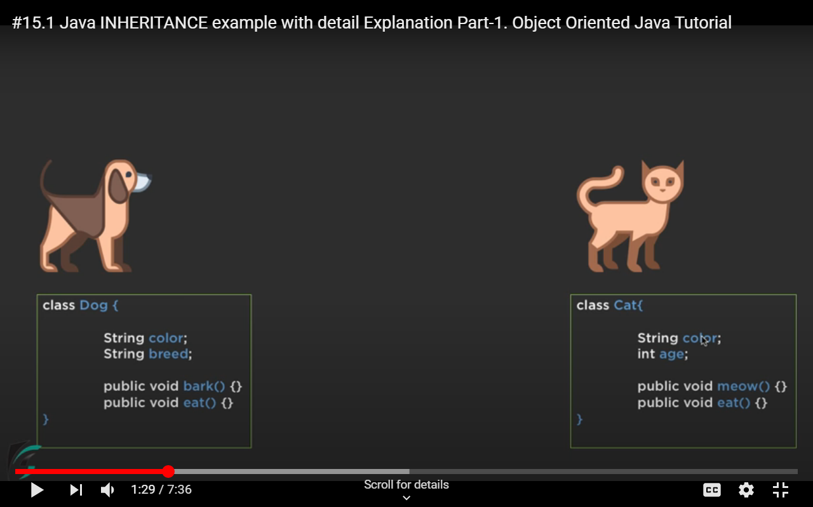
Why use inheritance in java
For Method Overriding (so runtime polymorphism can be achieved).
For Code Reusability.
Example

Slide 5
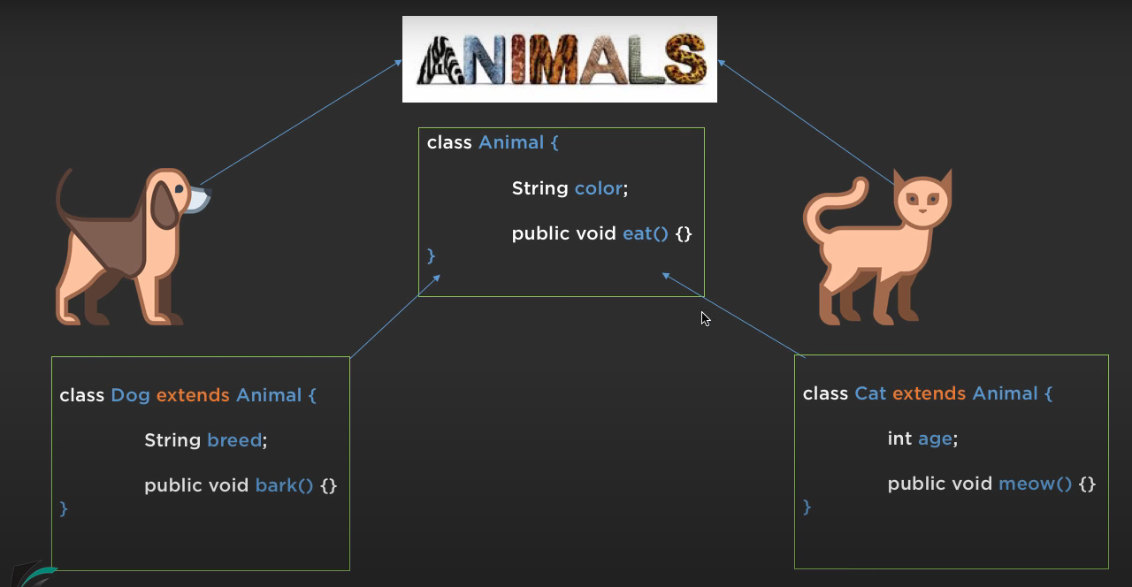

Slide 6
class A { int i, j; void showij() { System.out.println("i and j: " +i+ “ “ +j); } } class B extends A { int k; void showk() { System.out.println("k: " + k); } void sum() { System.out.println("i+j+k: " + (i+j+k)); } }
class SimpleInheritance { public static void main(String args[]) { A superOb = new A(); B subOb = new B(); superOb.i = 10; superOb.j = 20; superOb.showij(); i and j: 10 20 System.out.println(“------”); ------- subOb.i = 7; subOb.j = 8; subOb.k = 9; subOb.showij(); i and j: 7 8 subOb.showk(); k: 9 subOb.sum(); i+j+k: 24 } }

Slide 7
class A { int i; // public by default private int j; // private to A void setij(int x, int y) { i = x; j = y; } } class B extends A { int total; void sum() { total = i + j; } // ERROR, j is not accessible here } class Access { public static void main(String args[]) { B subOb = new B(); subOb.setij(10, 12); subOb.sum(); System.out.println("Total is " + subOb.total); } }

Slide 8
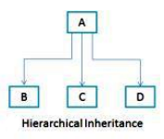
Different types of Inheritance :
Single Inheritance:
Only one super class
Multiple Inheritance :
Several super classes for a single sub class.
Java does not directly support this type of inheritance. This inheritance is implemented by using the concept of interfaces.
Hierarchical Inheritance :
One super class, many subclasses
Multilevel Inheritance :
A subclass becomes a superclass of another subclass

Slide 9
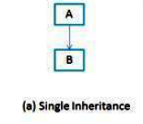
Single Inheritance
When a class extends another one class only then we call it a single inheritance.
The given diagram shows that class B extends only one class which is A. Here A is a parent class of B and B would be a child class of A.

Slide 10
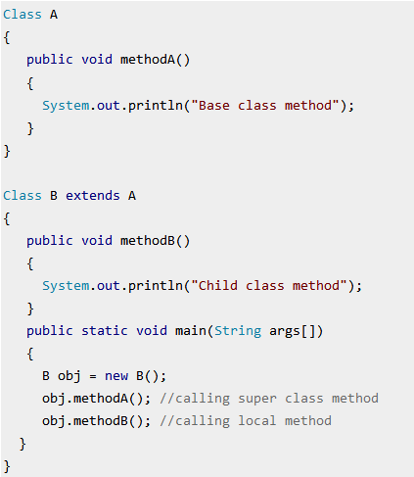

Slide 11
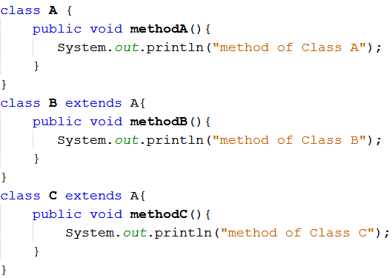
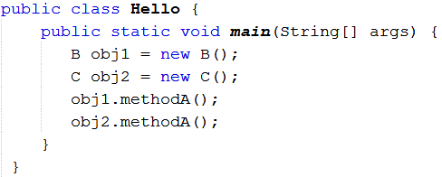
Hierarchical Inheritance :one class is inherited by several subclasses:

Slide 12
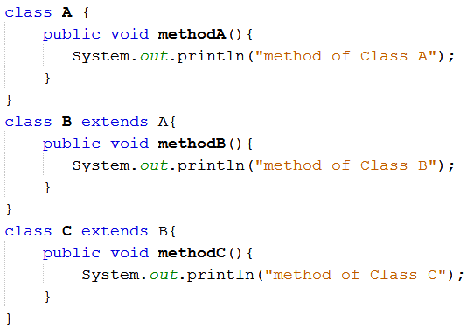
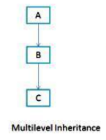
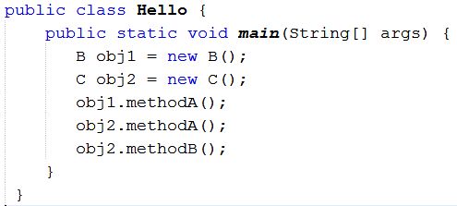
Multilevel Inheritance

Slide 13
super Keyword
If a subclass needs to refer to its immediate superclass, use a keyword called super.
super is used in the following two situations.
To calls the superclass constructor
General form: super(parameter-list);
super() must always be the first statement executed inside a subclass constructor
To access a member of the superclass that has been hidden by a member of a subclass.
General form: super.member
Here, member can be either a method or an instance variable

Slide 14
Example
class A{
A(){
System.out.println("in constructor A");
} }
class B extends A {
B(){
System.out.println("in constructore B");
} }
class SuperDemo
{
public static void main(String args[])
{
A obj= new A(); o/p in constructor A
}
}

Slide 15
Example
class A{
A(){
System.out.println("in constructor A");
} }
class B extends A{
B(){
//super(); by default child class calls the parent class constructor
System.out.println("in constructor B");
} }
class SuperDemo
{
public static void main(String args[])
{
B obj=new B(); o/p in constructor A
} in constructor B
}

Slide 16
Example
class A {
A(){
System.out.println("in constructor A");
}
A( int i){
System.out.println("in param constructor A");
} }
class B extends A{
B(){
System.out.println("in constructor B");
}
B( int i){
System.out.println("in param constructor B");
} }
class SuperDemo{
public static void main(String args[]){
B obj=new B(5); o/p ???
}}

Slide 17
Example
class A {
A(){
System.out.println("in constructor A");
}
A( int i){
System.out.println("in param constructor A");
} }
class B extends A{
B(){
System.out.println("in constructore B");
}
B( int i){ //super();
System.out.println("in param constructor B");
} }
class SuperDemo{
public static void main(String args[]){
B obj=new B(5); o/p in constructor A
}} in param constructor B

Slide 18
Example
class A {
A()
{ System.out.println("in constructor A"); }
A( int i){
System.out.println("in param constructor A");
} }
class B extends A{
B(){
System.out.println("in constructore B");
}
B( int i){
super(i);
System.out.println("in param constructor B");
} }
class SuperDemo{
public static void main(String args[]){
B obj=new B(5); o/p in param constructor A
}} in param constructor B

Slide 19
class Box { double width, height, depth; Box(Box ob) { width = ob.width; height = ob.height; depth = ob.depth; } Box(double w, double h, double d) { width = w; height = h; depth = d; } Box() { width = height = depth = -1; } Box(double len) { width = height = depth = len; } double volume() { return width * height * depth; } }
class BoxWeight extends Box { double weight; BoxWeight(double w, double h, double d, double m) { super(w, h, d); // call superclass constructor weight = m; } } class DemoBoxWeight { public static void main(String args[]) { BoxWeight mybox1 = new BoxWeight(10, 20, 15, 34.3); double vol = mybox1.volume(); System.out.println("Volume of mybox1 is " + vol); } } o/p Volume of mybox1 is 3000.0

Slide 20
class A { int i; } class B extends A { int i; // this i hides the i in A B(int a, int b) { super.i = a; // i in A i = b; // i in B } void show() { System.out.println("i in superclass: " + super.i); System.out.println("i in subclass: " + i); } } class UseSuper { public static void main(String args[]) o/p i in superclass: 1 { B subOb = new B(1, 2); i in subclass: 2 subOb.show(); } }

Slide 21
Q1) Create a class hierarchy as shown in below figure.
Student class
Mark class
Fees class

Slide 22
class student
{
int roll;
String name;
student(int r,String n)
{
roll=r;
name=n;
}
void display()
{
System.out.println("Name :"+name);
System.out.println("Roll No :"+roll);
}
}
class fees extends marks
{
int fee;
fees(int r,String n,int tot,int f)
{
super(r,n,tot);
fee=f;
}
void preview()
{
super.show();
System.out.println("Fees :"+fee);
}
}
class marks extends student
{
int total;
marks(int r,String n,int tot)
{ super(r,n);
total=tot;
}
void show()
{ super.display();
System.out.println("Total :"+total);
}
}
class multilevel
{
public static void main(String args[])
{
fees f1=new fees(1,"ABC",98,1000);
fees f2=new fees(2,"DEF",97,1200);
fees f3=new fees(3,"GHI",92,900);
f1.preview();
f2.preview();
f3.preview();
} }

Slide 23
Order of execution of constructors
class A { A() { System.out.println("Inside A"); } } class B extends A { B() { System.out.println("Inside B"); } } class C extends B { C() {System.out.println("Inside C"); } } class CallingCons { public static void main(String args[]) { C c = new C(); } }
In a class hierarchy, constructors are called in order of derivation, from superclass to subclass. If super( ) is not used, then the default or parameterless constructor of each superclass will be executed.
Output : Inside A Inside B Inside C

Slide 24
Polymorphism in Java
Polymorphism in Java is a concept by which we can perform a single action in different ways.
There are two types of polymorphism in Java: compile-time polymorphism and runtime polymorphism. We can perform polymorphism in java by method overloading(compile time polymorphism) and method overriding(run time polymorphism).

Slide 25
Method Overriding
Method overriding is one of the ways in which Java supports Runtime Polymorphism.
In a class hierarchy, when a method in a subclass has the same name and type signature as a method in its superclass, then the method in the subclass is said to override the method in the superclass.
When an overridden method is called from within a subclass, it will always refer to the version of that method defined by the subclass.
By using super we can access the superclass version of an overridden function.
Method overriding occurs only when the names and the type signatures of the two methods are identical. If they are not, then the two methods are simply overloaded.

Slide 26
class A { int i, j; A(int a, int b) { i = a; j = b; } void show() { System.out.println(i + “ " + j); } } class B extends A { int k; B(int a, int b, int c) { super(a, b); k = c; } void show()// this overrides { System.out.println("k: " + k); } }
class Override { public static void main(String args[]) { B subOb = new B(1, 2, 3); subOb.show(); // calls show() in B } }
Output : 3

Slide 27
class A { int i, j; A(int a, int b) { i = a; j = b; } void show() { System.out.println("i and j: " + i + " " + j); } } class B extends A { int k; B(int a, int b, int c) { super(a, b); k = c; } void show() { super.show(); // this calls A's show() System.out.println("k: " + k); } }
class Override { public static void main(String args[]) { B subOb = new B(1, 2, 3); subOb.show();// calls show() in B } }
Output : i and j : 1 2 k : 3

Slide 28
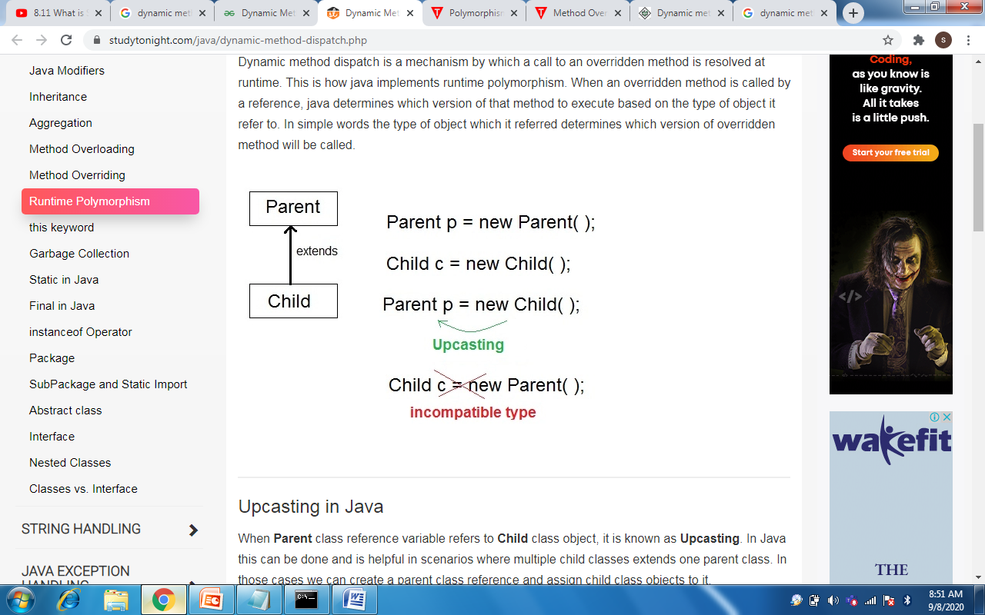
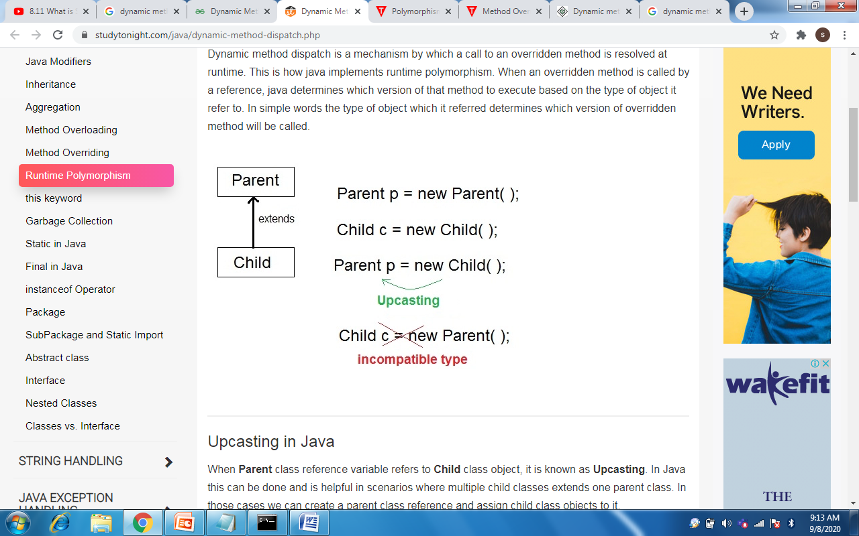
Dynamic Method Dispatch or Runtime polymorphism
Dynamic method dispatch is a mechanism by which a call to an overridden method is resolved at runtime. This is how java implements runtime polymorphism.
When Parent class reference variable refers to Child class object, it is known as Upcasting. In Java this can be done and is helpful in scenarios where multiple child classes extends one parent class. In those cases we can create a parent class reference and assign child class objects to it.
When an overridden method is called through a superclass reference, Java determines which version of that method to execute based upon the type of the object being referred to at the time the call occurs.
Method overridding is resolved at run time, rather than compile time. Hence it is an example for run-time polymorphism.

Slide 29
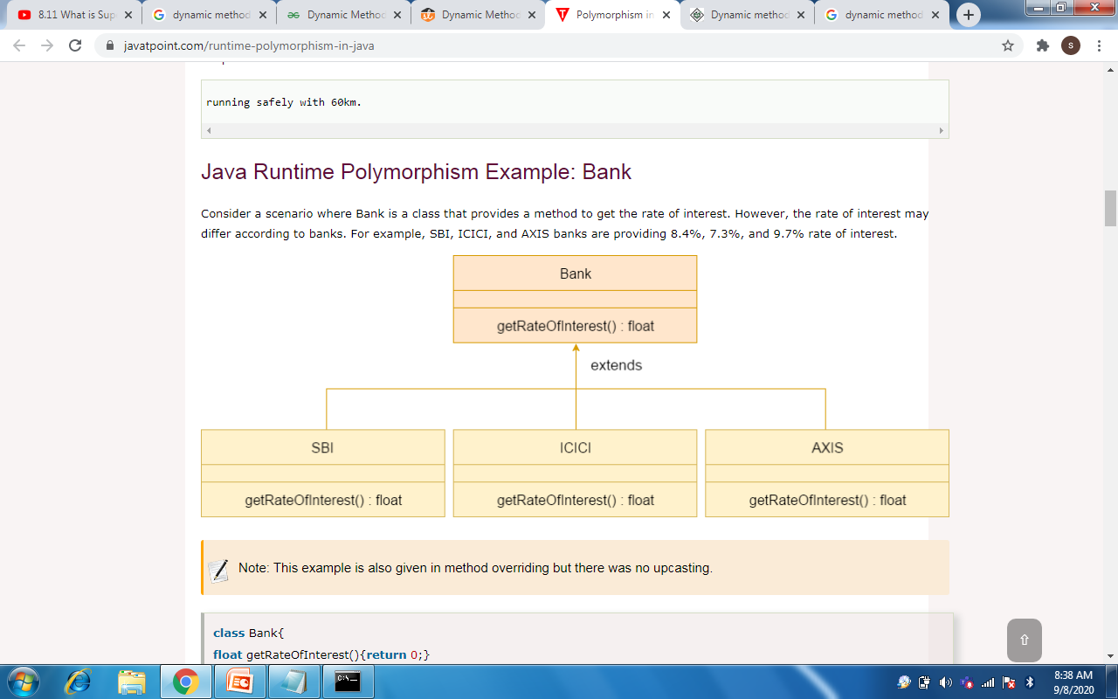

Slide 30
Sample code
class Bank{
float getRateOfInterest(){return 0;}
}
class SBI extends Bank{
float getRateOfInterest(){return 8.4f;}
}
class AXIS extends Bank{
float getRateOfInterest(){return 7.4f;}
}
class TestPolymorphism{
public static void main(String args[])
{
Bank b=new SBI();
//Upcasting is typecasting of a child object to a parent object as shown above
System.out.println("SBI Rate of Interest: "+b.getRateOfInterest());
b=new AXIS(); //Upcasting
System.out.println("AXIS Rate of Interest: "+b.getRateOfInterest());
} o/p SBI Rate of Interest: 8.4
} AXIS Rate of Interest: 7.4

Slide 31
class A { void callme() { System.out.println("Inside A"); } } class B extends A { void callme() { System.out.println("Inside B"); } } class C extends A { void callme() { System.out.println("Inside C"); } }
class Dispatch { public static void main(String args[]) { A a = new A(); // object of type A B b = new B(); // object of type B C c = new C(); // object of type C A r; // obtain a reference of type A r = a; // r refers to an A object r.callme(); // calls A's callme r = b; // r refers to a B object r.callme(); // calls B's callme r = c; // r refers to a C object r.callme(); // calls C's callme } }
Output : Inside A Inside B Inside C

Slide 32
class Parent{
int x=10;
void show(){ System.out.println("parent-show"); }
void OnlyParentShow(){ System.out.println("OnlyParentShow"); }
}
class Child extends Parent{
int x=20;
void show(){ System.out.println("child-show"); }
void OnlyChildShow(){ System.out.println("OnlyChildShow"); }
}
public class ParentChild {
public static void main(String[] args) {
Parent p = new Child();
p.show();
p.OnlyParentShow();
System.out.println(p.x);
}
}

Slide 33
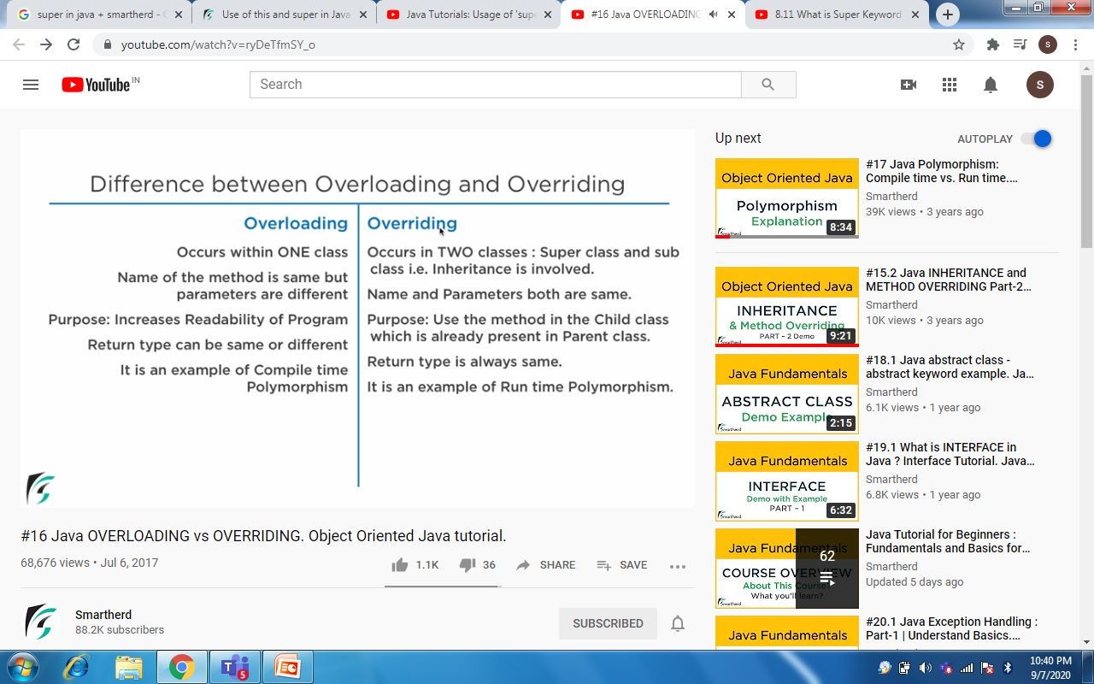

Slide 34
Abstract Methods and Classes
Data abstraction is the process of hiding certain details and showing only essential information to the user.
Abstraction can be achieved with either abstract classes or interfaces
The abstract keyword is used for classes and methods:
Abstract class: is a restricted class that cannot be used to create objects (to access it, it must be inherited from another class).
Abstract method: can only be used in an abstract class, and it does not have a body. The body is provided by the subclass (inherited from).
An abstract class can have both abstract and regular methods:

Slide 35
Abstract Methods and Classes
Abstract method are those methods that lack definition(i.e. body). It must always be redefined in the subclass.
Overriding is compulsory for abstract methods.
General form: abstract type name(parameter-list);
An abstract class is a superclass that only defines a generalized form that will be shared by all of its subclasses, leaving it to each subclass to fill in the details.
Example: abstract class Shape
{ …………….
abstract void draw();
………………
}

Slide 36
Abstract classes must satisfy the following conditions:
1.Abstract classes are not used to instantiate objects directly
2.The abstract method of the abstract class must be defined in its subclass.
3.We can not declare abstract constructors or abstract static methods
Abstract classes can be used to create object references. This reference can be used to point to a subclass object.

Slide 37
abstract class Bank {
abstract int getRateOfInterest();
}
class ICICI extends Bank
{
int getRateOfInterest() { return 5; }
}
class HDFC extends Bank {
int getRateOfInterest() { return 6; }
}
class TestBank {
public static void main(String args[]) {
Bank b; b=new ICICI();
System.out.println("Rate of Interest ICICI: "+b.getRateOfInterest()); b=new HDFC();
System.out.println("Rate of Interest HDFC : "+b.getRateOfInterest()); } } Output: Rate of Interest ICICI: 5 Rate of Interest HDFC: 6

Slide 38
abstract class A { abstract void callme(); void callmetoo() {System.out.println("This is a concrete method."); } } class B extends A { void callme() {System.out.println("B's implementation of callme."); } } class AbstractDemo { public static void main(String args[]) { B b = new B(); b.callme(); b.callmetoo(); } }
Output : B's implementation of callme This is a concrete method.

Slide 39
abstract class Figure { double dim1, dim2; Figure(double a, double b) { dim1 = a; dim2 = b; } abstract double area(); } class Rectangle extends Figure { Rectangle(double a, double b) { super(a, b); } double area() { System.out.println("Inside Rect"); return dim1 * dim2; } } class Triangle extends Figure { Triangle(double a, double b) { super(a, b); } double area() {System.out.println("Inside Tri“); return dim1 * dim2 / 2; } }
class AbstractAreas { public static void main(String args[]) { // Figure f = new Figure(10, 10); // illegal Rectangle r = new Rectangle(9, 5); Triangle t = new Triangle(10, 8); Figure figref; // OK, no object is created figref = r; System.out.println( figref.area()); figref = t; System.out.println( figref.area()); } }

Slide 40
Final Variables, Methods and Classes
The keyword final has three uses.
Equivalent to named constants :
The value of the final variable can never be changed.
Final variables behave like class variables and they do not take any space on individual objects of the class.
Example : final int size=100;
To Prevent Overriding :
To prevent the subclasses from overriding the members of the super class, we can declare them as final in its super class using the keyword final.
To Prevent Inheritance :
Precede the class declaration with final.
Declaring a class as final implicitly declares all of its methods as final, too.
It is illegal to declare a class as both abstract and final

Slide 41
class A { final void meth() {System.out.println("This is a final method."); } } class B extends A { void meth() { // ERROR! Can't override. System.out.println("Illegal!"); } }
final class A { // ... } // The following class is illegal. class B extends A { // ERROR! Can't subclass A // ... }

Slide 42
Object class in Java
Object class is present in java.lang package.
Every class in Java is directly or indirectly derived from the Object class.
If a Class does not extend any other class then it is direct child class of Object and if extends other class then it is indirectly derived.
Therefore the Object class methods are available to all Java classes and it acts as a root of inheritance hierarchy in any Java Program.

Slide 43
Object defines the following methods
Object clone() – It returns a new object that is exactly the same as this object.
boolean equals(Object object)- Determines whether one object is equal to another.
void finalize()- This method is called just before an object is garbage collected.
Class getClass()- Obtains the class of an object at run time.
int hashCode()- Returns the hash code associated with the invoking object.
void notify()- Resumes execution of a thread waiting on the invoking object.
void notifyAll()- Resumes execution of all threads waiting on the invoking object.
String toString()- Returns a stirng that describes the object.
Void wait()- Waits on another thread of execution.
The methods getClass(), notify(), notifyAll() and wait() are declared as final.

